Slide 1
EXPORT MARKETING
EXPORT MARKETING
DR.SUMITA SHANKAR

Slide 2
What is Export ?
Goods produced in one country are sent to other countries for sale

Slide 3
What is import
The import trade is referred to goods and services purchased into one nation from another.

Slide 4
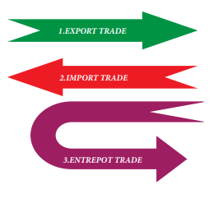
What is entrepôt
Trade in which imported goods are re-exported with or without any additional processing or repackaging.

Slide 5
DIFINITION OF EXPORT MARKETING
DEFINITIONS OF EXPORT MARKETING
B. S. Rathor “Export marketing includes the management of marketing activities for products which cross the national boundaries of a country”.
“Export marketing means marketing of goods and services beyond the national boundaries”

Slide 6
FEATURES OF EXPORT MARKETING
1. Systematic Process
2. Large Operations
3. Dominance of Multi-National Corporations
4. Customer Focus
5. Trade Barriers
6. Trading Blocs

Slide 7
FEATURES OF EXPORT MARKETING
7. Three Faced- Competition
8. Documentation
9. Foreign Exchange Regulations
10. Spreading of Risk.
11. International Marketing Research

